Slide 1

Lecture – 8 Inheritance and Polymorphism in Java
Afsara Tasneem Misha
Lecturer
Department of CSE
Daffodil International University

Slide 2
Contents
Inheritance in Java
Method Overriding in Inheritance
Polymorphism in Java

Slide 3
Topic - 1 : Inheritance in Java

Slide 4
Introduction to Inheritance
Inheritance in Java is a mechanism in which one object acquires all the properties and behaviors of a parent object.
It is an important feature of OOPs.
Inherited class is called as parent class or super class or base class
Class that inherits a parent class is called as child class or sub class or derived class
‘extends’ keyword is used to inherite a class
Inheritance represents the IS-A relationship which is also known as a parent-child relationship.

Slide 5
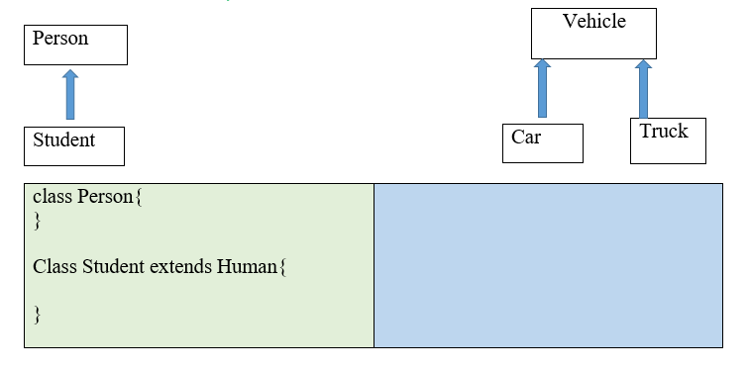
IS-A relationship
Super Class/Parent Class/Base Class
Sub Class/Child Class/Derived Class
Student is a Person
Car is a Vehicle
Truck is a Vehicle

Slide 6
extends Keyword
extends is the keyword used to inherit the properties of a class.
class SuperClass{
.....
.....
}
class SubClass extends SuperClass{
.....
}
SuperClass
extends
SubClass

Slide 7
extends Keyword
class Person{ …… } class Student extends Person{ ……… } | Try by Yourself

Slide 8
Example – 1
class Employee{
float salary=40000;
}
class Programmer extends Employee{
float bonus=10000;
public static void main(String args[]){
Programmer p=new Programmer();
System.out.println("Programmer salary is:"+p.salary);
System.out.println("Bonus of Programmer is:"+p.bonus);
}
}
Employee
salary: float
extends
Programmer
bonus: float
+main(String[]):void

Slide 9
Example – 1: Output
class Employee{
float salary=40000;
}
class Programmer extends Employee{
float bonus=10000;
public static void main(String args[]){
Programmer p=new Programmer();
System.out.println("Programmer salary is:"+p.salary);
System.out.println("Bonus of Programmer is:"+p.bonus);
}
}
Output: Programmer salary is: 40000.0 Bonus of programmer is: 10000.0

Slide 10
Example – 2
public class Teacher {
String designation = “Leturer";
String uniName = “DIU";
public void job()
{
System.out.println("Teaching");
}
}
Teacher
designation: String uniName: String
+job() : void
Output:
DIU
Leturer
CSE
Teaching
public class CseTeacher extends Teacher{
String mainSubject = “CSE";
public static void main(String[] args){
CseTeacher obj = new CseTeacher();
System.out.println(obj.uniName);
System.out.println(obj.designation);
System.out.println(obj.mainSubject);
obj.job();
}
}
CseTeacher
mainSubject: String
+main(String[]):void

Slide 11
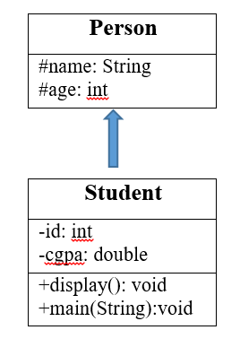
Example – 3
Example - 3

Slide 12
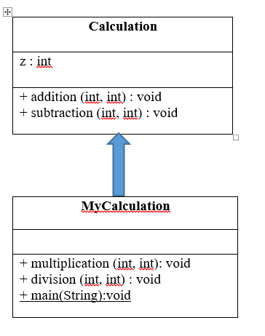
Example – 4

Slide 13
Example – 4: Solution
public class MyCalculation extends Calculation {
public void multiplication(int x, int y) {
z = x * y;
System.out.println("The product :"+z);
}
public void division(int x, int y) {
z = x / y;
System.out.println("The Division :"+z);
}
public static void main(String[] args) {
int a = 20, b = 10;
MyCalculation demo = new MyCalculation();
demo.addition(a, b);
demo.Subtraction(a, b);
demo.multiplication(a, b);
demo.division (a, b);
}
}
public class Calculation {
int z;
public void addition(int x, int y) {
z = x + y;
System.out.println("The sum :"+z);
}
public void subtraction(int x, int y) {
z = x - y;
System.out.println("The difference :"+z);
}
}

Slide 14
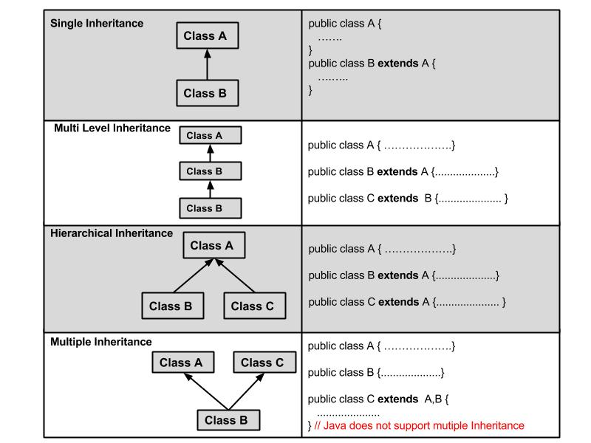
Types of inheritance

Slide 15
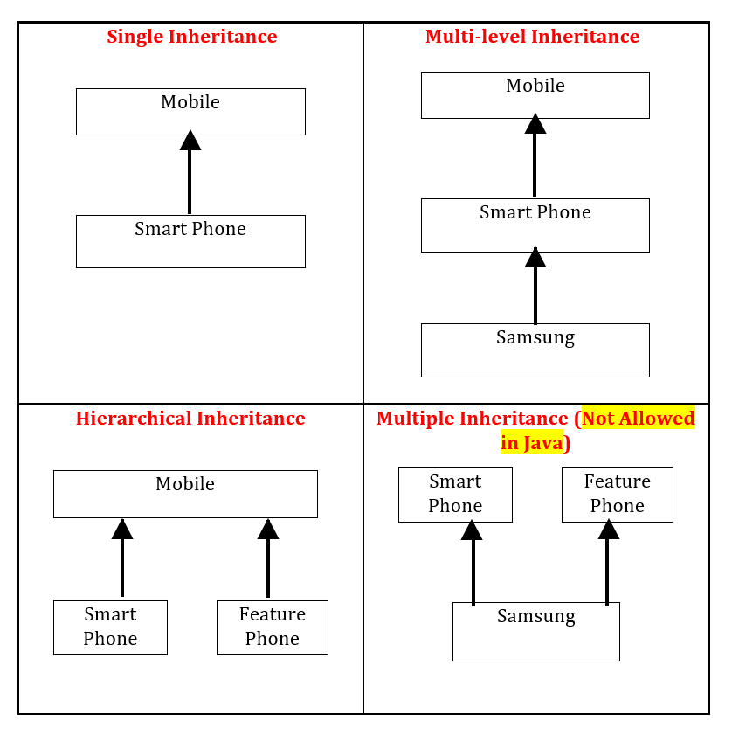
Types of inheritance

Slide 16
Topic - 2 : Method Overriding in Java

Slide 17
Method Overriding used in Inheritance
If subclass (child class) has the same method as declared in the parent class, it is known as method overriding in Java.
In other words, if a subclass provides the specific implementation of the method that has been declared by one of its parent class, it is known as method overriding.
Method overriding is used for runtime polymorphism

Slide 18
Rules for Method Overriding
The method must have the same name as in the parent class
The method must have the same parameter as in the parent class.
There must be an IS-A relationship (inheritance)

Slide 19
Let's understand the problem that we may face in the program if we don't use method overriding
class Vehicle{
void run(){
System.out.println("Vehicle is running");
}
}
class Bike extends Vehicle{ public static void main(String args[]){ Bike bike = new Bike(); bike.run(); } }
Output Vehicle is running

Slide 20
Java Program to illustrate the use of Method Overriding
Example – 5
Method overriding
class Vehicle{
void run(){
System.out.println("Vehicle is running");
}
}
class Bike extends Vehicle{ void run(){ System.out.println("Bike is running safely"); } public static void main(String args[]){ Bike bike = new Bike (); //creating object bike.run(); //calling method } }
Output Bike is running safely

Slide 21
Example – 6
Human
+eat() : void
Boy
+eat() : void +main(String[]):void
Girl
+eat() : void +main(String[]):void

Slide 22
‘super’ keyword
The super keyword is similar to this keyword.
It is used to differentiate the members of super_class from the members of sub_class if they have same name.
It is used to invoke the constructor of super_class from the sub_class.
Usage of super Keyword
1. super is used to refer immediate parent class instance variable.
super.variable;
2. super is used to invoke immediate parent class method.
super.method();
3. super() is used to invoke immediate parent class constructor.
super();

Slide 23
If a class is inheriting the properties of another class and if the members of the superclass have the names same as the sub class, to differentiate these variables we use super keyword as shown below.
1) super is used to refer immediate parent class instance variable
Problem without super keyword
Solution by super keyword
public class Vehicle{ int speed=50; } public class Bike extends Vehicle{ int speed=100; void display() { System.out.println(speed); } public static void main(String args[]){ Bike b=new Bike(); b.display(); } }
Output: ?
class Vehicle{ int speed = 50; } class Bike extends Vehicle{ int speed =100; void display(){ System.out.println(super.speed); } public static void main(String args[]){ Bike b = new Bike(); b.display(); } }
Output: ?

Slide 24
public class Vehicle { int speed = 50; public void display() { System.out.println("\nVehicle Speed = " +speed); } } public class Car extends Vehicle { public void display() { super.display(); System.out.println("Car Speed = " + super.speed); } public static void main(String[] args) { Car c1 = new Car(); c1.display(); } }
Output: This is Sub Class This is Super Class
2) super is used to refer immediate parent class method
The super keyword can also be used to invoke parent class method. It should be used in case subclass contains the same method as parent class as in the example given below

Slide 25
public class Vehicle { int speed = 50; public Vehicle(int speed) { System.out.println("Vehicle is created"); this.speed = speed; } } public class Car extends Vehicle { public Car() { super(100); System.out.println("Car is created"); } public void display() { System.out.println("\nVehicle Speed = " + super.speed); System.out.println("Car Speed = " +speed); } public static void main(String[] args) { Car c1 = new Car(); c1.display(); } }
Output: Vehicle is created Car is created Vehicle Speed = 100 Car Speed = 100
3) super is used to invoke parent class constructor
If a class is inheriting the properties of another class, the subclass automatically acquires the default constructor of the super class. But if you want to call a parametrized constructor of the super class, you need to use the super keyword as shown below.

Slide 26
public class Car extends Vehicle {
int speed = 100;
public Car()
{
super("Red");
System.out.println("Car is Created\n");
}
public void display()
{
super.display();
System.out.println("Vehicle Speed is: "+super.speed);
System.out.println("Car Speed is: "+speed);
}
public static void main(String[] args) {
Car c1 = new Car();
c1.display();
}
}
Example – 7
public class Vehicle {
int speed = 50;
public Vehicle(String color) {
System.out.println("Vehicle is created with color:" + color);
}
public void display() {
System.out.println("The vehicle Speed is: " + speed);
}
}

Slide 27
UML of Example - 7
Vehicle
# speed : int
+ Vehicle(int) + display(): void
Car
speed : int
+ Car() + display(): void + main(String) : void

Slide 28
Example – 8
Person
# name : String # age: int
+ Person(String, int) + display(): void
Student
- id: int - cgpa : double
+Student(String, int , int, double) +display(): void +main(String) : void

Slide 29
Why use inheritance in java
Code Reusability
The idea behind inheritance in Java is that you can create new classes that are built upon existing classes.
When you inherit from an existing class, you can reuse methods and fields of the parent class.
Moreover, you can add new methods and fields in your current class also.
Method Overriding
To provide the specific implementation of a method which is already provided by its superclass.

Slide 30
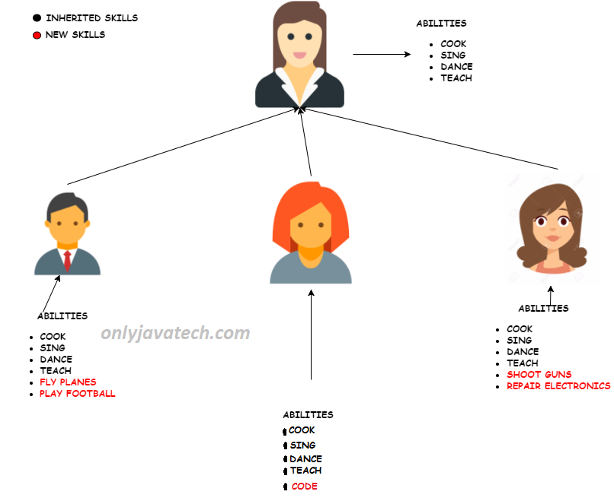
Inheritance in Java

Slide 31
Topic - 3 : Polymorphism in Java

Slide 32
Introduction to Polymorphism
Two types of Polymorphism
Compile-time Polymorphism : Method Overloading
Run-time Polymorphism : Method Overriding

Slide 33

Thank you!

